Slide 1


CLASSIFICATION: EMPLOYEE CHURN
PROJECT 3 | METIS FALL 2019
CARISSA SOSA
Notes:
Talking employee churn
classification problem thru IBM case study

Slide 2
MOTIVATION
Cost of replacing an employee is between 90% and 200% of their annual salary₁
U.S. employers paid $600 billion in turnover costs in 2018₂
Companies can expect that annual cost to increase to $680 billion by 2020₂
1. SHRM
2. Tennessee-based Work Institute
Notes:
Why do we care?

Slide 3
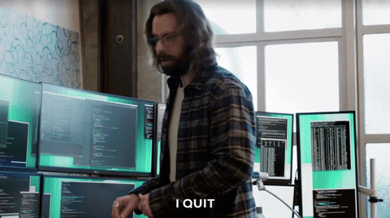
Notes:
Bottom Line – Expensive when employees Churn
-which leads me to my objective and goals

Slide 4
OBJECTIVE AND GOALS
Predict Employee Churn
Classification Model Selection
Feature Selection
Notes:
In order to assist IBM with predicting employee churn –
Feature Selection
Classification Model Selection
Which will give IBM the power to continue to predict employee churn at will

Slide 5
METHODOLOGY – DATA & TOOLS
Dataset – IBM HR Analytics Employee Attrition & Performance₃
Compare ROC/AUC scores across multiple classification models
Focus on Recall (Sensitivity) = TP / (TP + FN)
Tableau/Flask
3. Kaggle
Notes:
Dataset - IBM HR Analytics Employee Attrition & Performance
Compare ROC/AUC socres
Focus on recall because want to catch as many employees that will potentially churn as possible
Tableau/Flask to help visualize

Slide 6
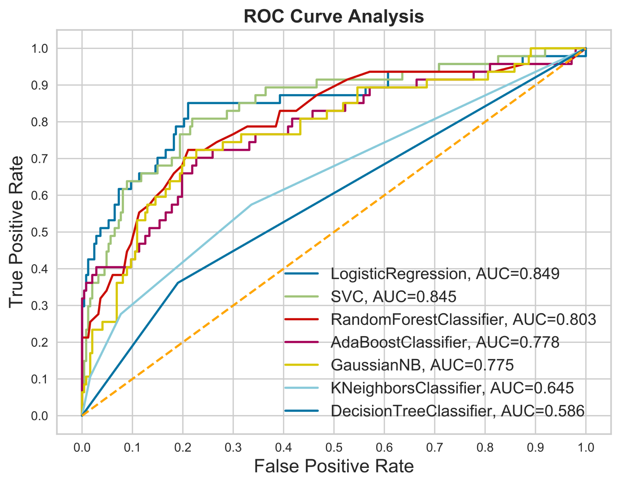
BASELINE ROC/AUC CURVE
Notes:
To just get a baseline I plotted data on an ROC_AUC curve
Top 3
LR
SVC
RFC
AUC 0.849

Slide 7
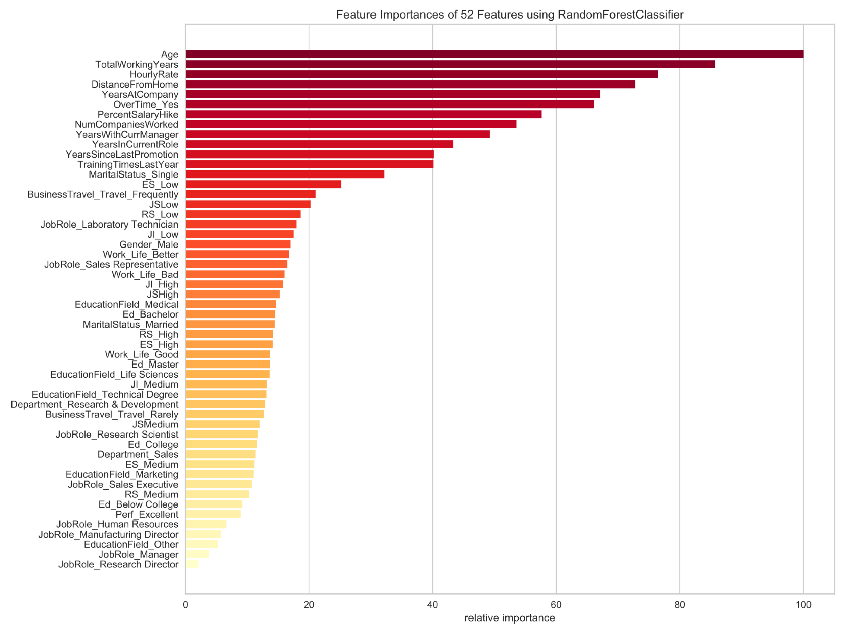
RANDOMFORESTCLASSIFIER
Notes:
ROC/AUC score was similar for Random Forest – decided to use this classifier to select my features as it’s highly interpretable
Started with 52 features and got rid of just a bit of noise at the bottom, to increase my ROC_AUC socres

Slide 8
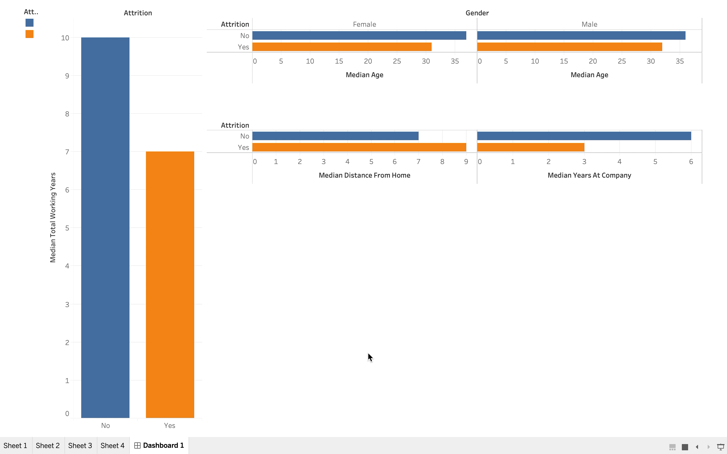
TABLEAU EDA
Notes:
EDA of some of top features
Median Total working years - 7 years
7 year itch
Median Age for employee churn
Women 31
Men 32 - quarter life crisis
Median Age for employee churn
Distance from home
Women further away more likely to churn
Men seem to like working further away from home...

Slide 9
METHODOLOGY - STEPS
STANDARDIZED
SMOTE/ADASYN
(80:20)
ROC/AUC
GRIDSEARCH CV
Notes:
upsampling models w/ SMOTE/ADASYN – but when plotted on ROC/AUC scores went down, so didn’t end up upsampling
Tuned hyperparameters with GridSearch CV

Slide 10
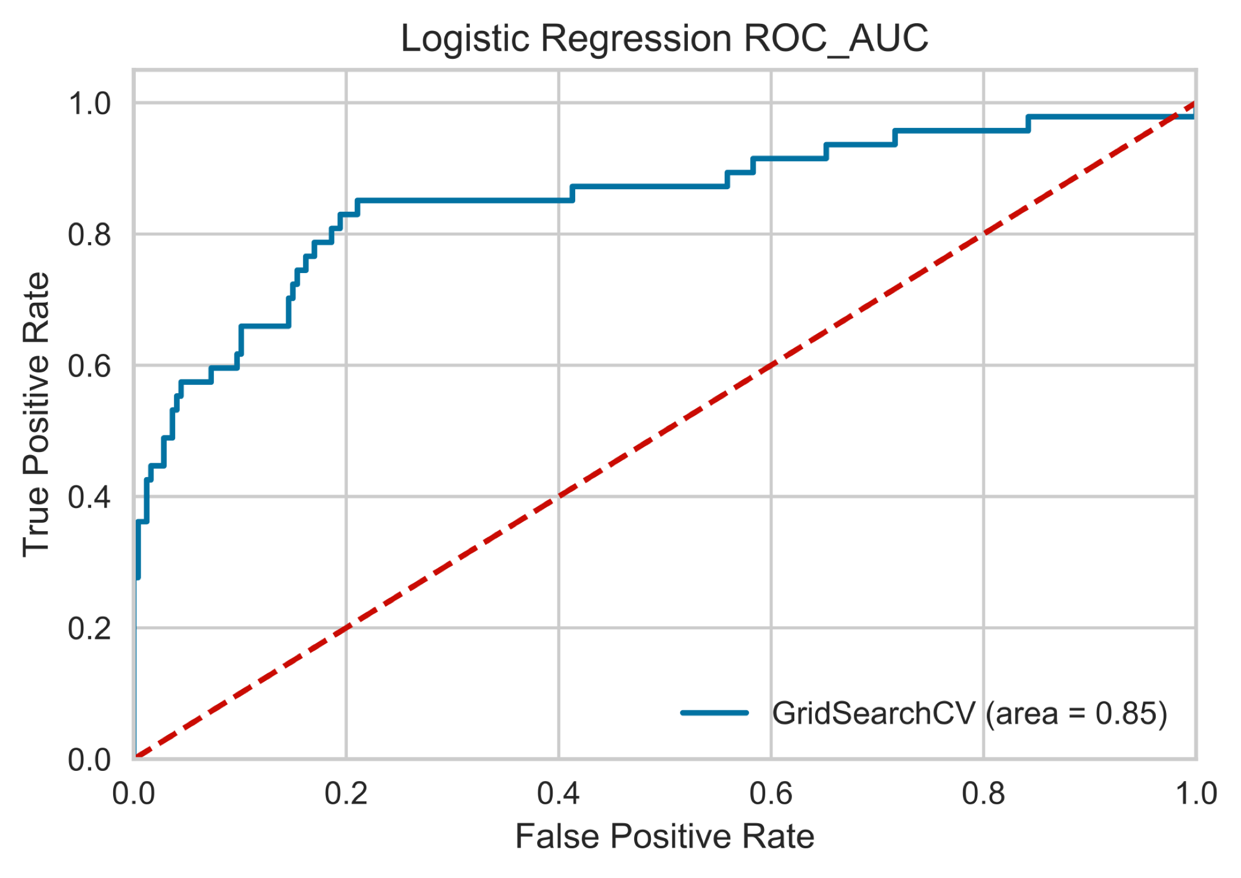
RESULTS - MODEL
AUC | Recall
0.85 | 0.81
Notes:
Chose Logistic Regression as classification model
High Recall score I was looking

Slide 11
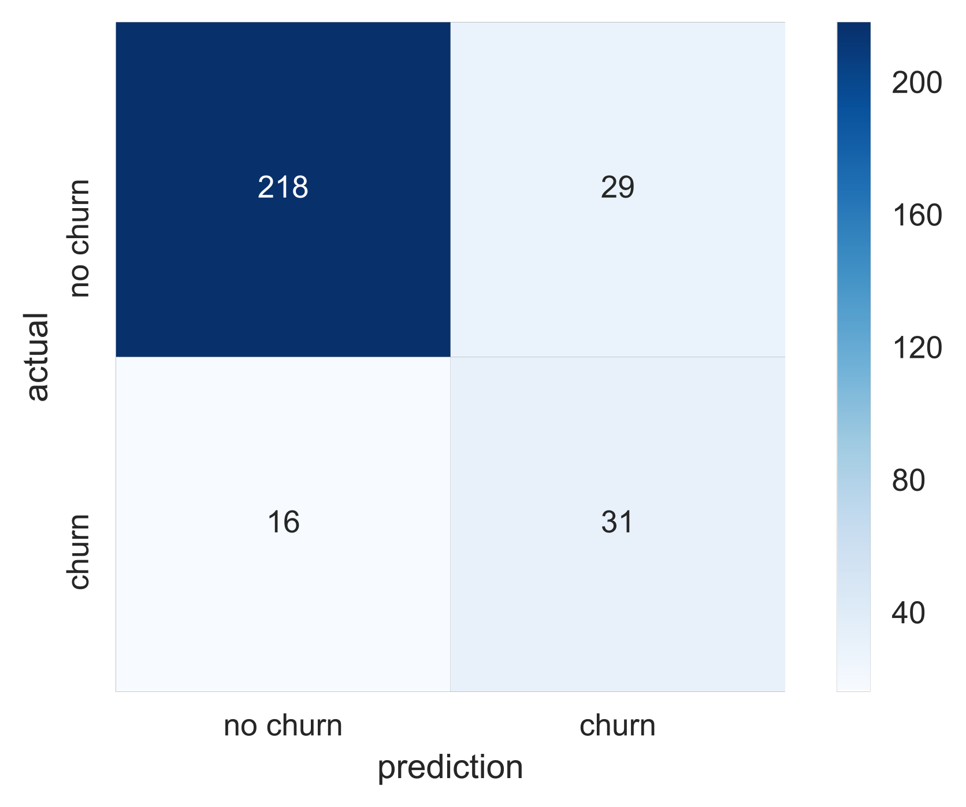
RESULTS ON TEST SET
Threshold: | 0.3
Precision | 0.5806
Recall | 0.6632
Notes:
False Positives - higher in sensitive model
Not detrimental – have the opportunity to reach out or resurvey these employees
Plot precision recall curve and selected threshold of 30% - maximize recall - False Positives of employees who churn but won’t, without tanking precision too badly

Slide 12
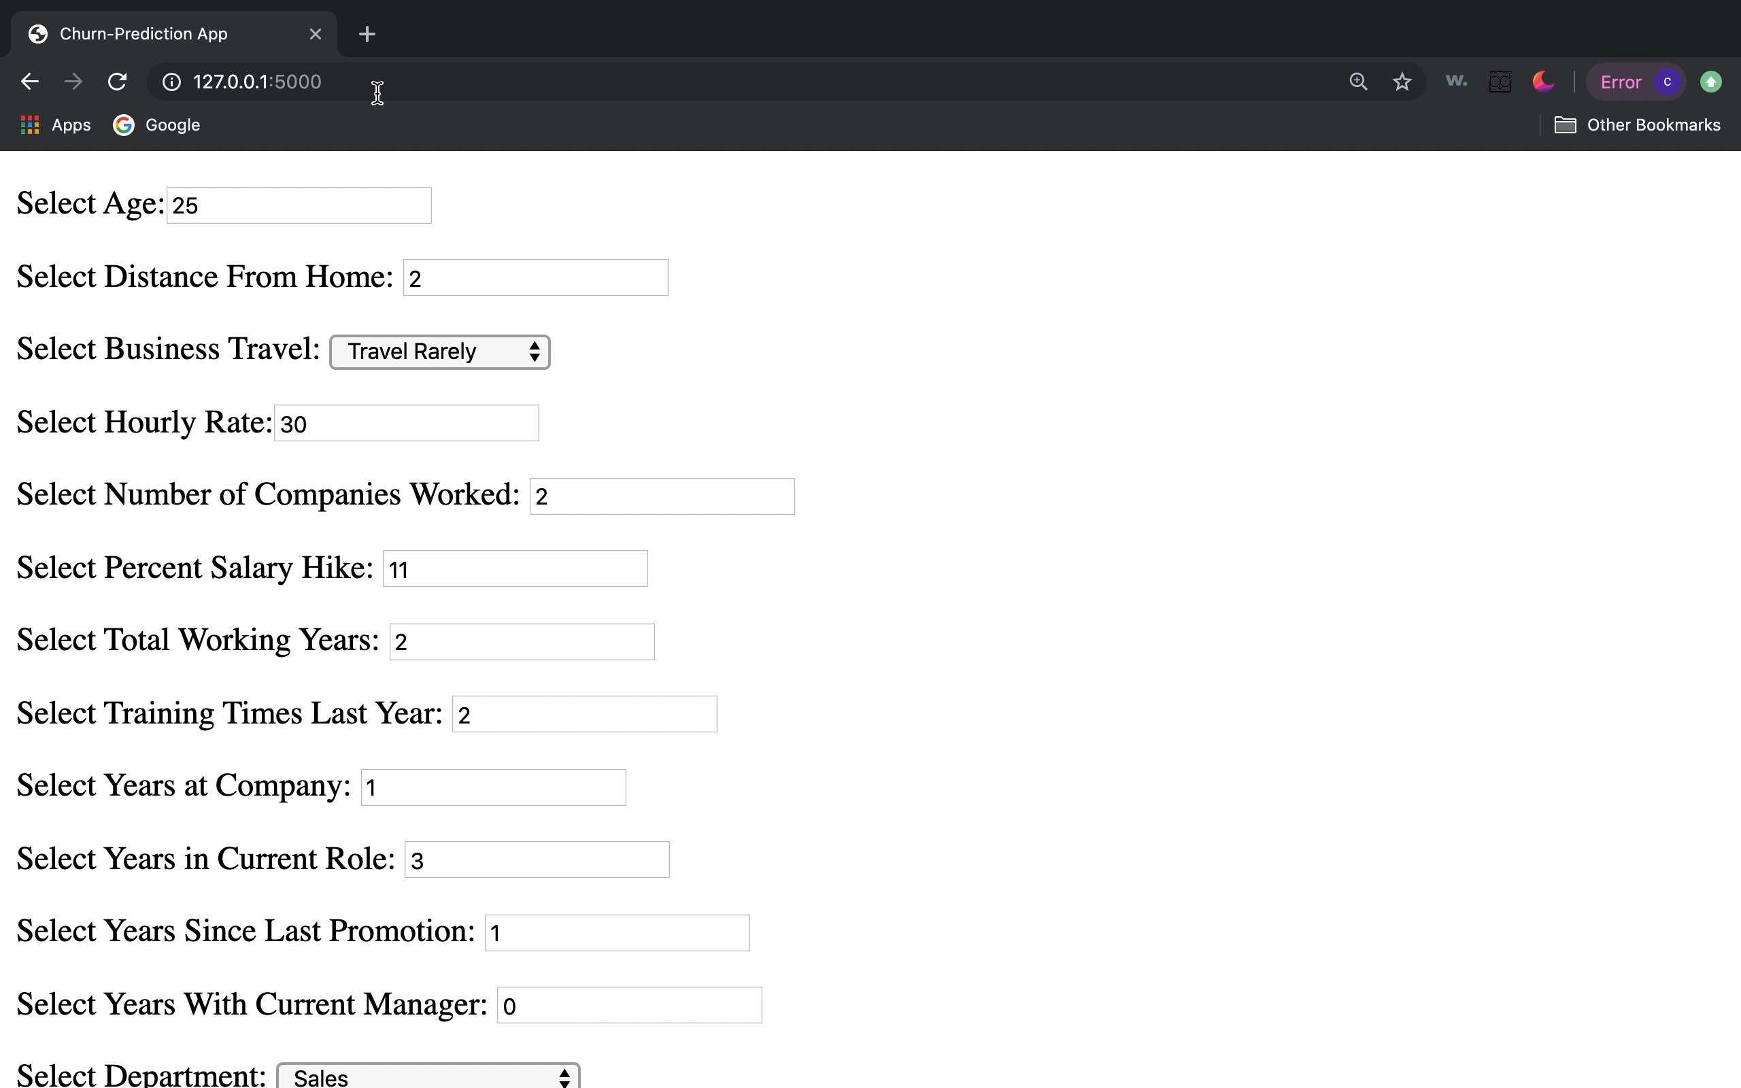
RESULTS – FLASK APP
Notes:
Skeleton of Flask App, client can use to predict if an employee will churn or not
Tailor response accordingly

Slide 13
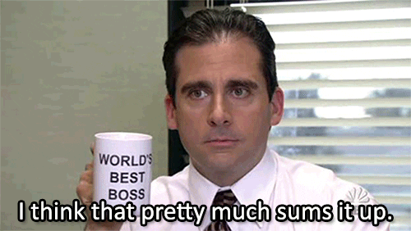
CONCLUSION
Logistic Regression Classification Algorithm
Several attributing factors that impact employee churn
Focus on Recall - don’t be afraid of higher false positives
Notes:
Attributing factors to employee churn for this dataset – age, distance from home, work life balance
Don’t be afraid of higher false positives – can always reach out or resurvey those individuals – better to catch someone before they give notice and company incurs turnover cost

Slide 14
THANKS!
Questions?

Slide 15
APPENDIX

Slide 16
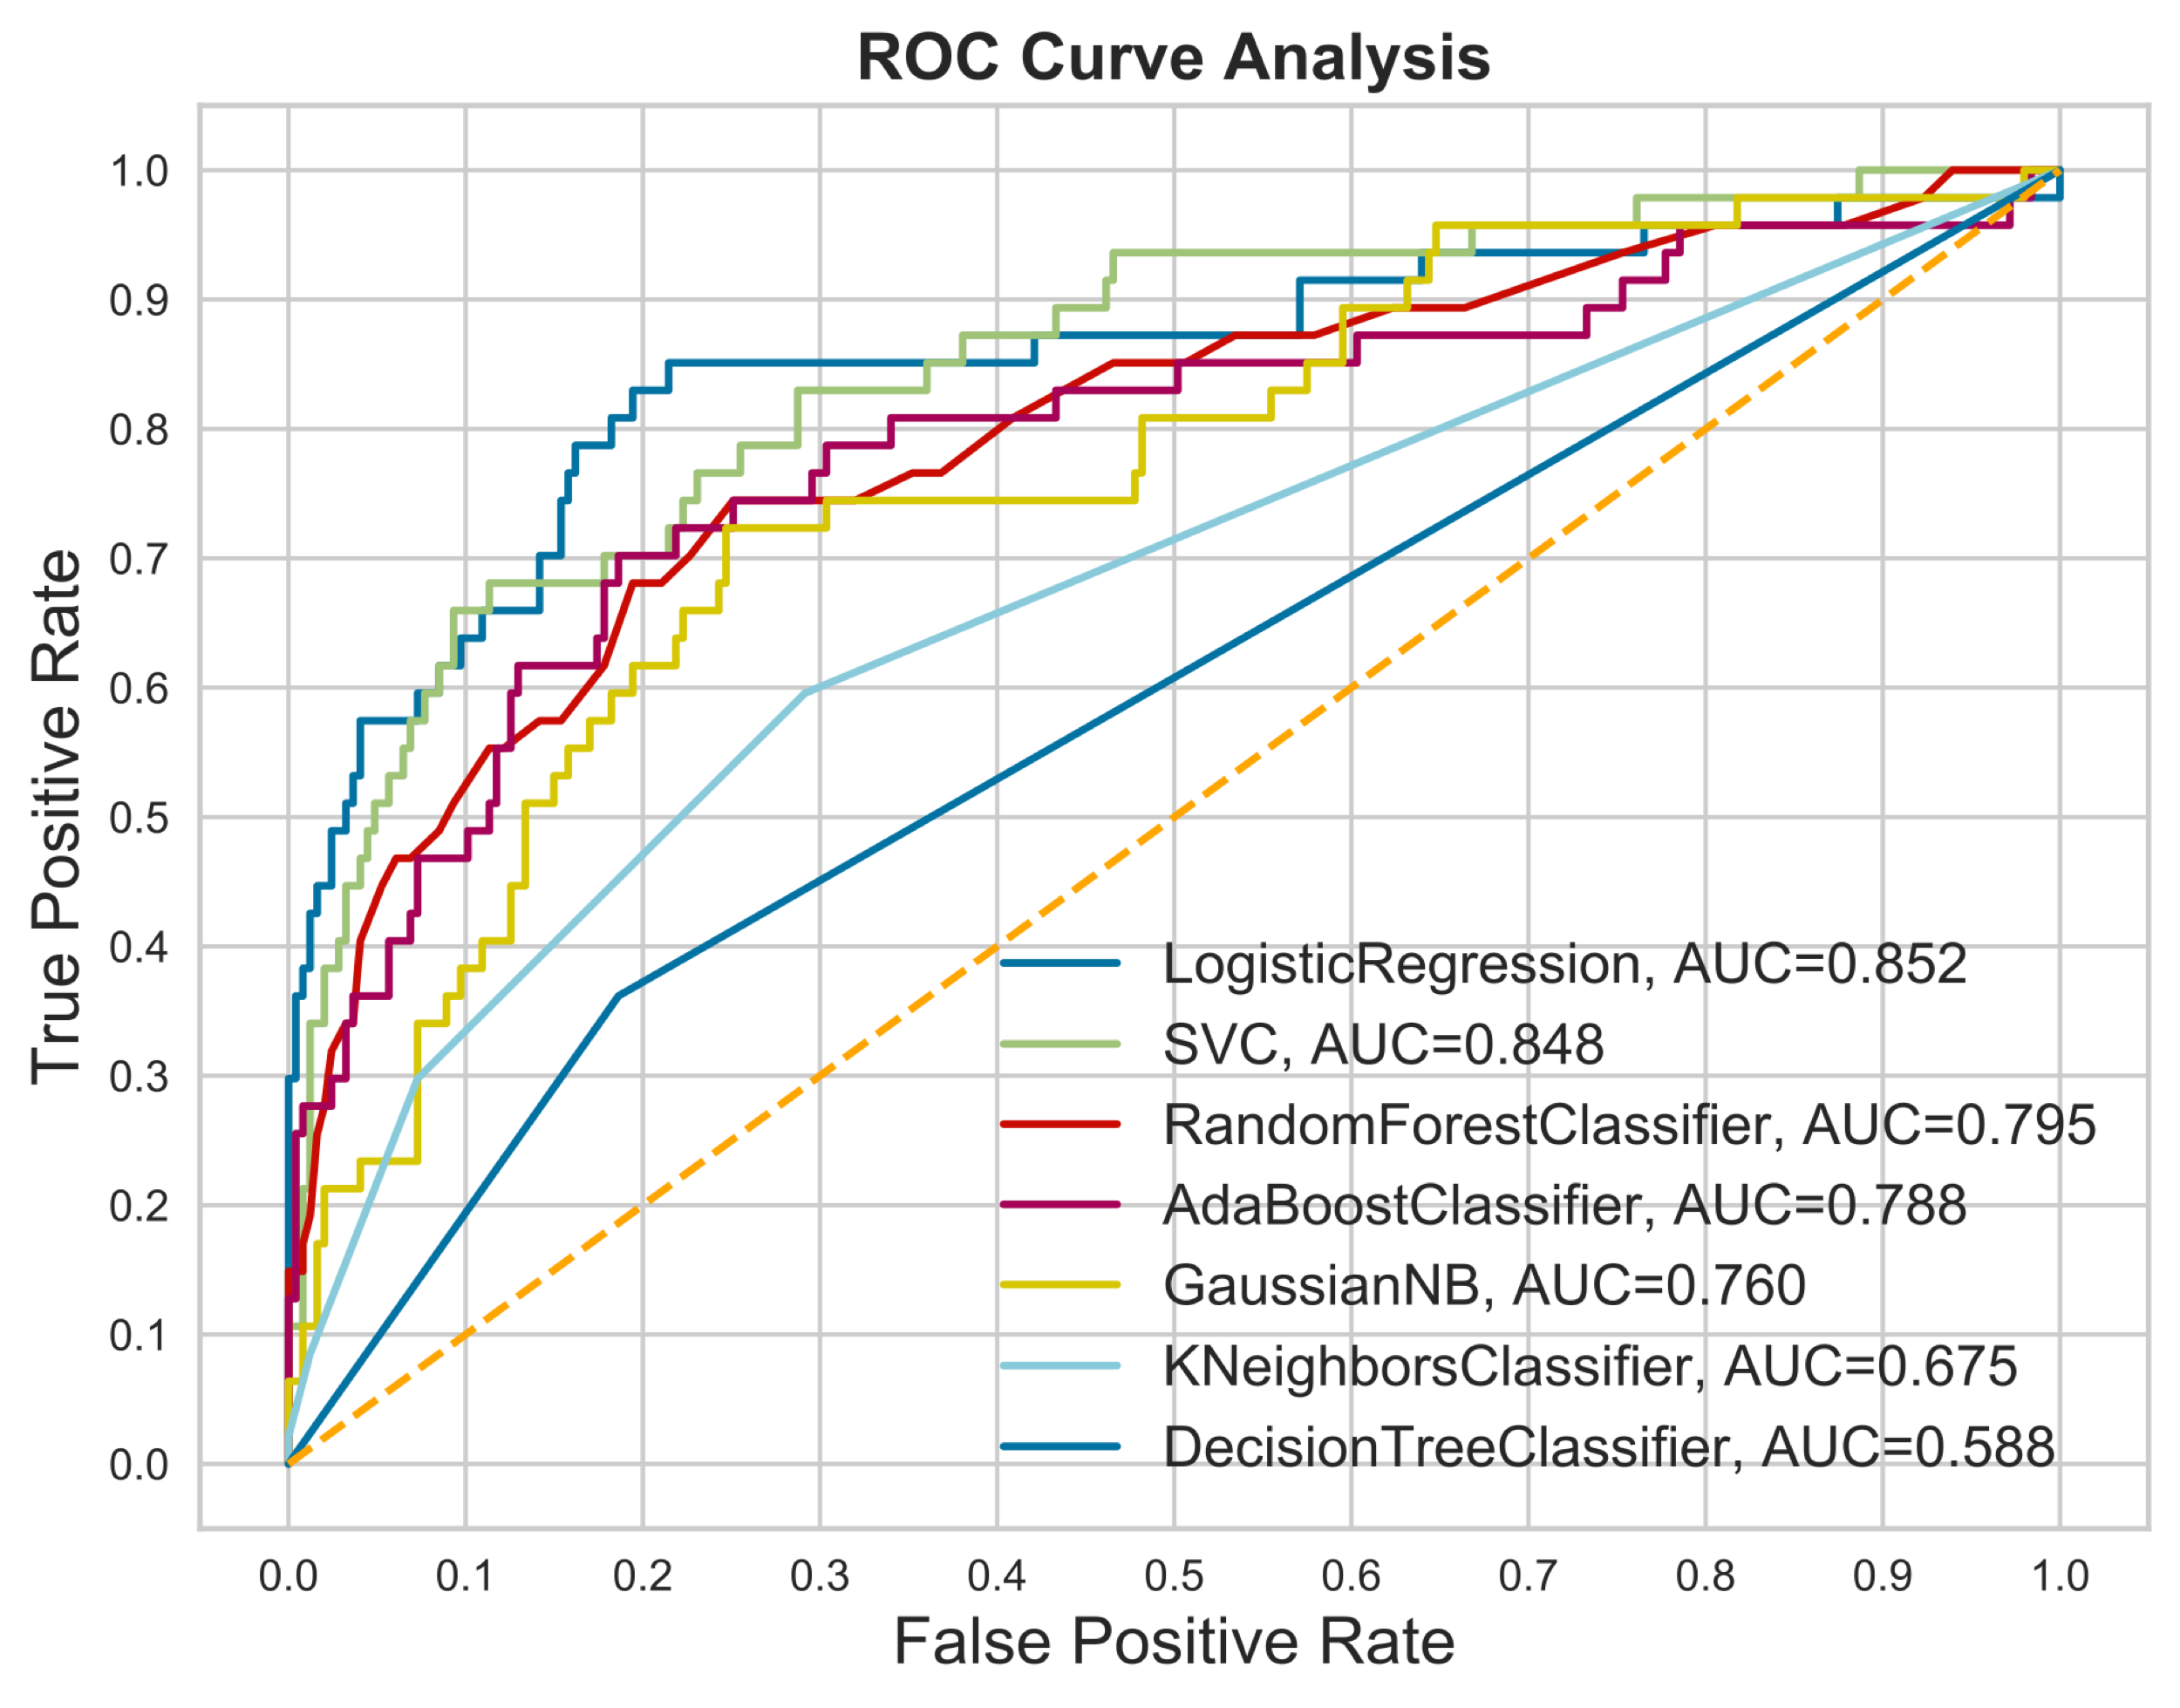
STANDARDIZED & REDUCED FEATURES ROC/AUC
Notes:
Standardized and reduced features logistic regression highest

Slide 17
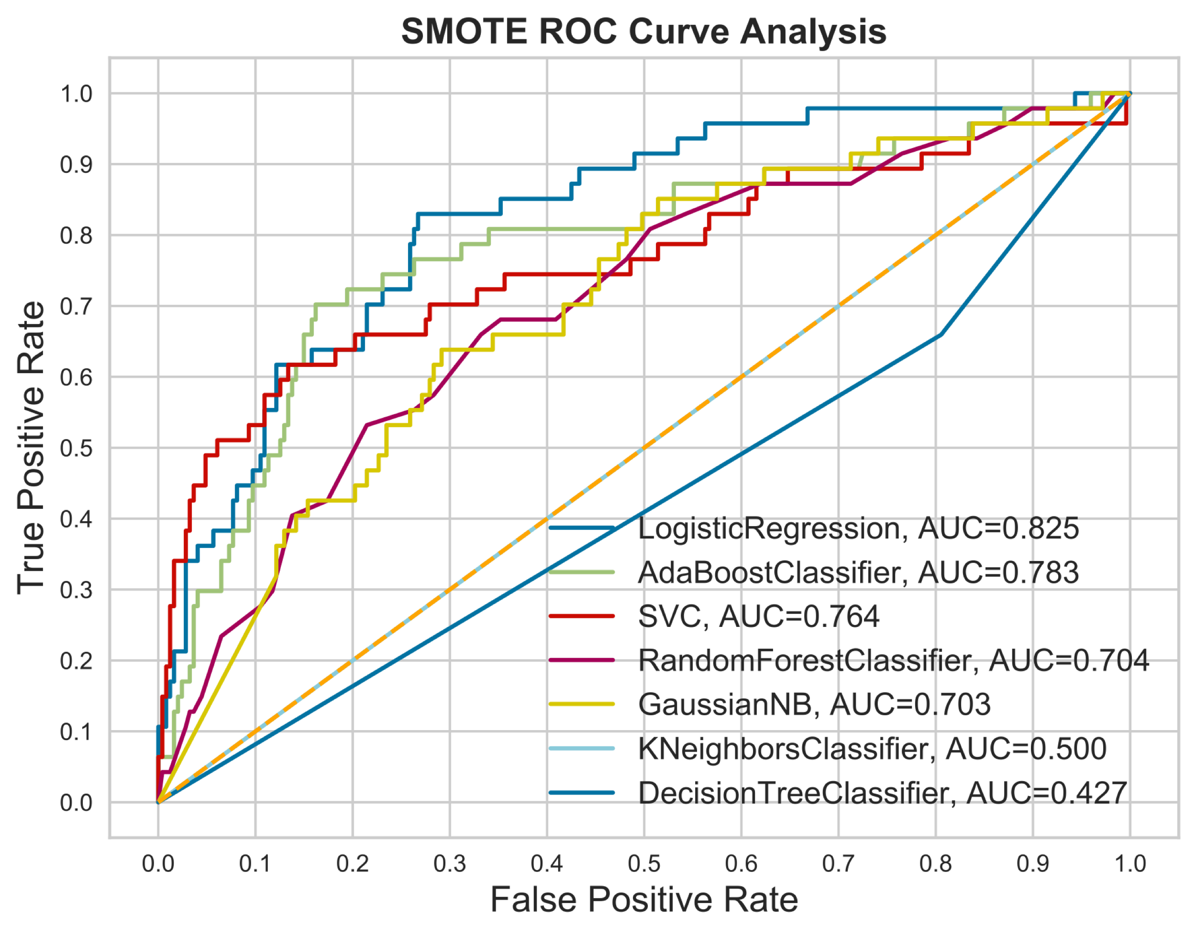
STANDARDIZED & SMOTE
Notes:
SMOTE when down

Slide 18
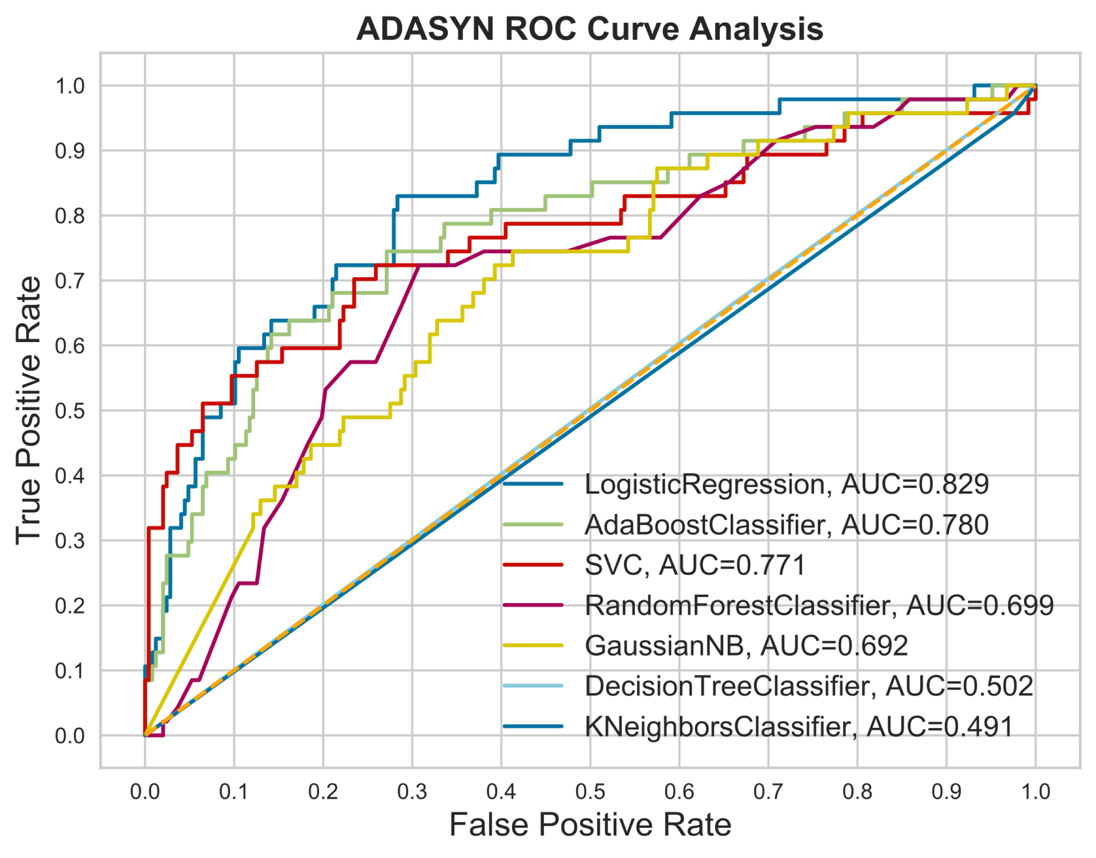
STANDARDIZED & ADASYN
Notes:
ADASYN went down

Slide 19
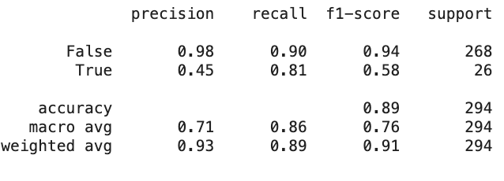
Confusion Matrix for selected model

Slide 20
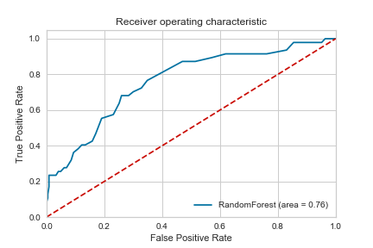
Standardizing, Balancing,
GridSearch CV
RandomForest, but did
worse than logistic
regression
PRECISION RECALL CURVE
Notes:
Precision recall curve
Beta between 0-1, recall more important
Set threshold at 30%

Slide 21
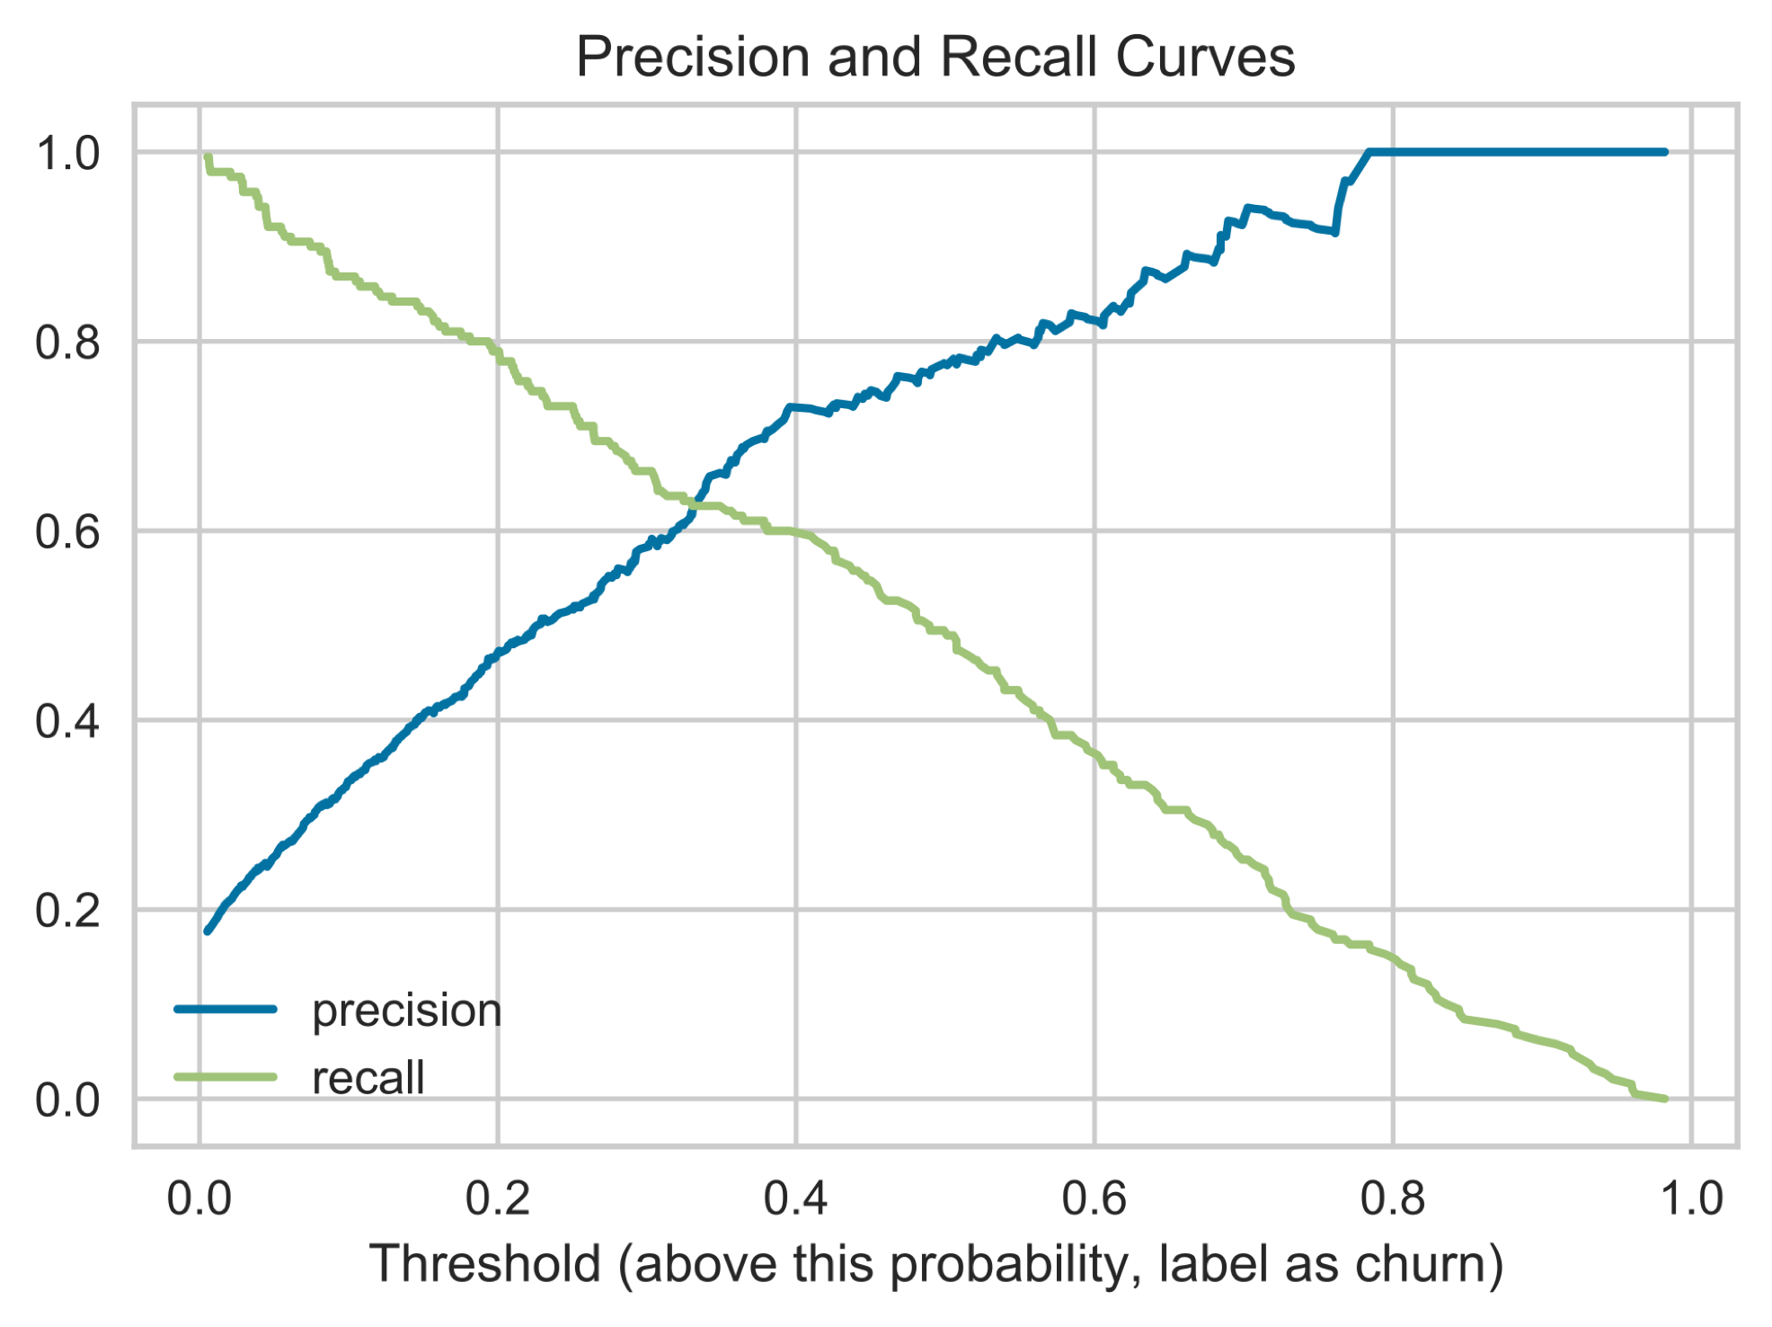
Set Threshold for 30%
Maximize recall
PRECISION RECALL CURVE
Notes:
Precision recall curve
Beta between 0-1, recall more important
Set threshold at 30%

Slide 27
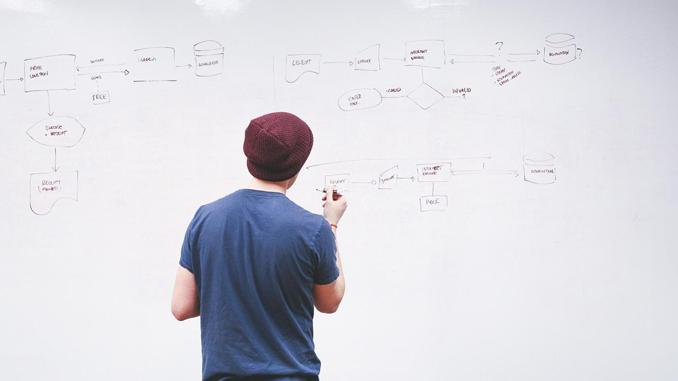
HELLO!
I am Jayden Smith
I am here because I love to give presentations.
You can find me at @username

Slide 28
Quotations are commonly printed as a means of inspiration and to invoke philosophical thoughts from the reader.

Slide 29
This is a slide title
Here you have a list of items
And some text
But remember not to overload your slides with content
Your audience will listen to you or read the content, but won’t do both.

Slide 30
You can also split your content
White
Is the color of milk and fresh snow, the color produced by the combination of all the colors of the visible spectrum.
Black
Is the color of coal, ebony, and of outer space. It is the darkest color, the result of the absence of or complete absorption of light.

Slide 31
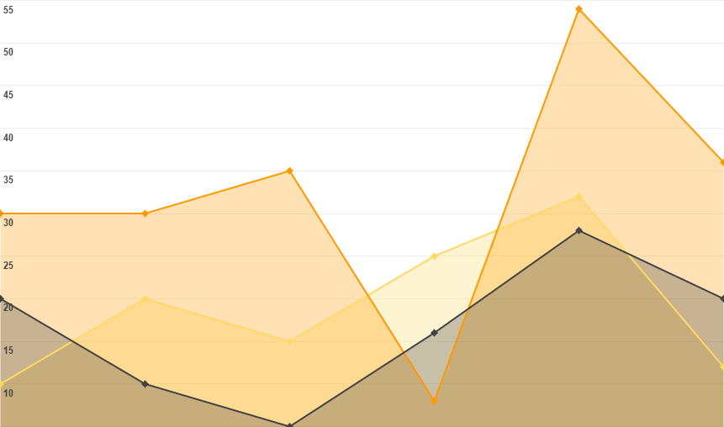
You can insert graphs from Google Sheets

Slide 32
In two or three columns
Yellow
Is the color of gold, butter and ripe lemons. In the spectrum of visible light, yellow is found between green and orange.
Blue
Is the colour of the clear sky and the deep sea. It is located between violet and green on the optical spectrum.
Red
Is the color of blood, and because of this it has historically been associated with sacrifice, danger and courage.

Slide 33

Want big impact? USE BIG IMAGE

Slide 34
Use charts to explain your ideas
White
Gray
Black

Slide 35
And tables to compare data
 | A | B | C
Yellow | 10 | 20 | 7
Blue | 30 | 15 | 10
Orange | 5 | 24 | 16

Slide 36
Maps
our office

Slide 37
89,526,124
Whoa! That’s a big number, aren’t you proud?

Slide 38
89,526,124$
185,244 users
100%
That’s a lot of money
And a lot of users
Total success!

Slide 39
Our process is easy
first
second
last

Slide 40
Let’s review some concepts
Yellow
Is the color of gold, butter and ripe lemons. In the spectrum of visible light, yellow is found between green and orange.
Blue
Is the colour of the clear sky and the deep sea. It is located between violet and green on the optical spectrum.
Red
Is the color of blood, and because of this it has historically been associated with sacrifice, danger and courage.
Red
Is the color of blood, and because of this it has historically been associated with sacrifice, danger and courage.
Yellow
Is the color of gold, butter and ripe lemons. In the spectrum of visible light, yellow is found between green and orange.
Blue
Is the colour of the clear sky and the deep sea. It is located between violet and green on the optical spectrum.

Slide 41
ANDROID PROJECT
Show and explain your web, app or software projects using these gadget templates.
Place your screenshot here

Slide 42
iPHONE
PROJECT
Show and explain your web, app or software projects using these gadget templates.
Place your screenshot here

Slide 43
TABLET
PROJECT
Show and explain your web, app or software projects using these gadget templates.
Place your screenshot here

Slide 44
DESKTOP PROJECT
Show and explain your web, app or software projects using these gadget templates.
Place your screenshot here

Slide 45
APPENDIX
Special thanks to all the people who made and released these awesome resources for free:
Presentation template by SlidesCarnival
Photographs by Startupstockphotos

Slide 46
Presentation design
This presentation uses the following typographies and colors:
Titles: Dosis
Body copy: Roboto
You can download the fonts on these pages:
https://www.fontsquirrel.com/fonts/dosis
https://material.google.com/resources/roboto-noto-fonts.html
Orange #ff8700
You don’t need to keep this slide in your presentation. It’s only here to serve you as a design guide if you need to create new slides or download the fonts to edit the presentation in PowerPoint®

Slide 47
SlidesCarnival icons are editable shapes.
This means that you can:
Resize them without losing quality.
Change line color, width and style.
Isn’t that nice? :)
Examples:

Slide 48
😉
Now you can use any emoji as an icon!
And of course it resizes without losing quality and you can change the color.
How? Follow Google instructions https://twitter.com/googledocs/status/730087240156643328
✋👆👉👍👤👦👧👨👩👪💃🏃💑❤😂😉😋😒😭👶😸🐟🍒🍔💣📌📖🔨🎃🎈🎨🏈🏰🌏🔌🔑 and many more...

